Slide 1
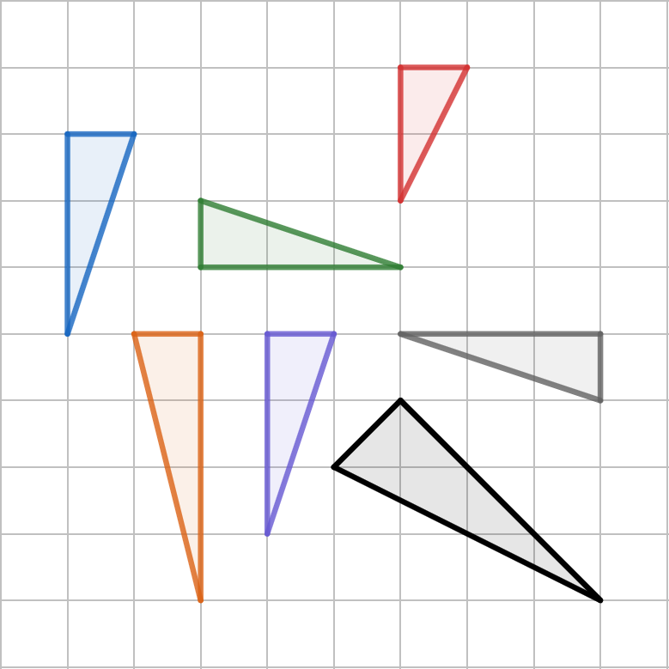
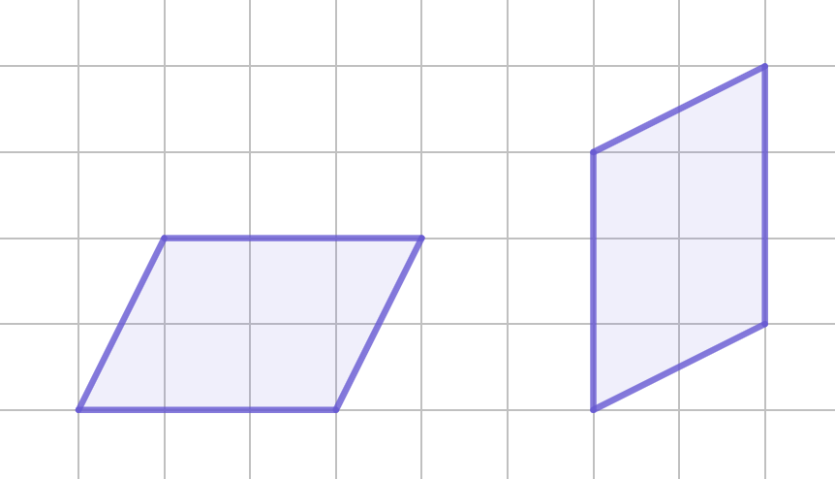
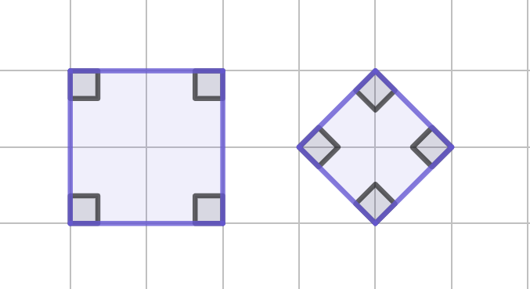
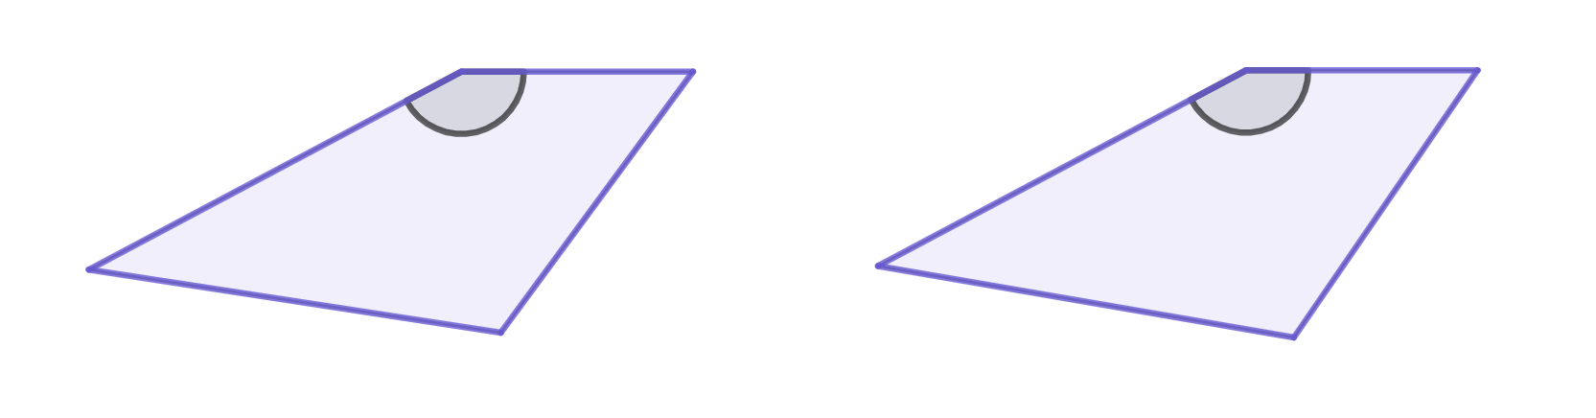
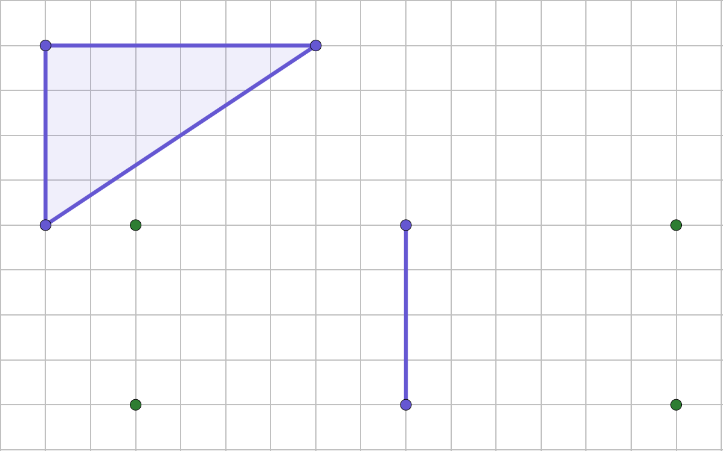
Checking understanding of basic transformations
Task A: Congruency
Which of these triangles are congruent?
C
A, B, E and F are congruent to each other.
A
B
D
E
F
G
Are the two shapes congruent or not? If not, why not?
b)
Congruent
Not congruent as the sizes are different.
c)
3 cm
3 cm
5.5 cm
152°
5.4 cm
152°
4.2 cm
4.2 cm
5.4 cm
5.5 cm
These shapes are not congruent as the edges with the same length are in different places.
Mark where you could put the third vertex to make the two triangles congruent. One edge has been given.
There are four places you could have chosen.

Slide 2
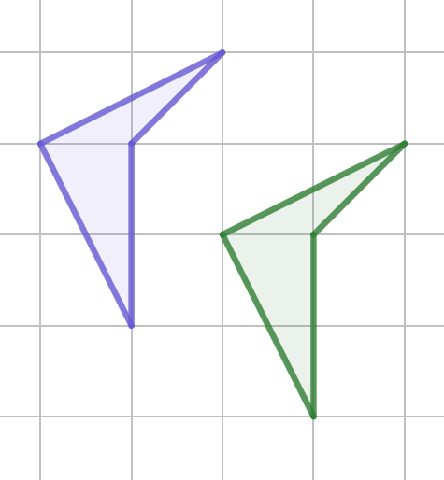
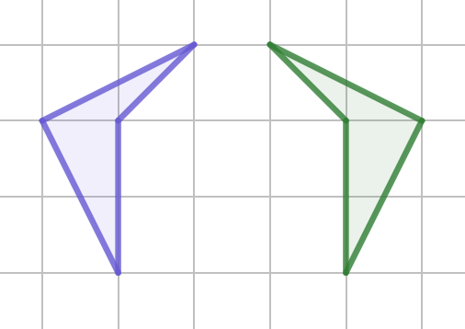
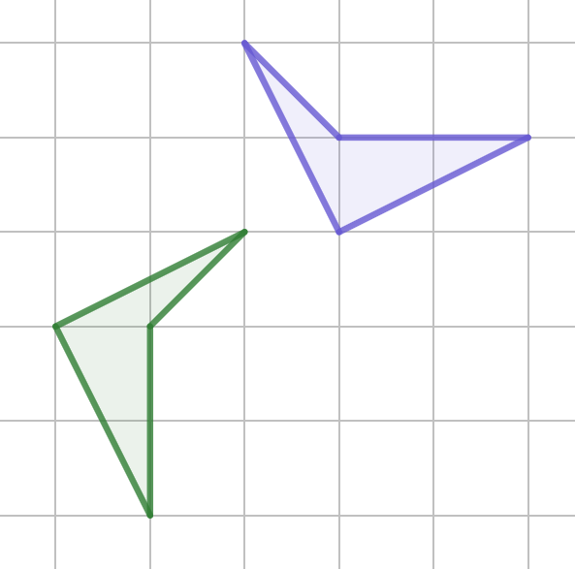
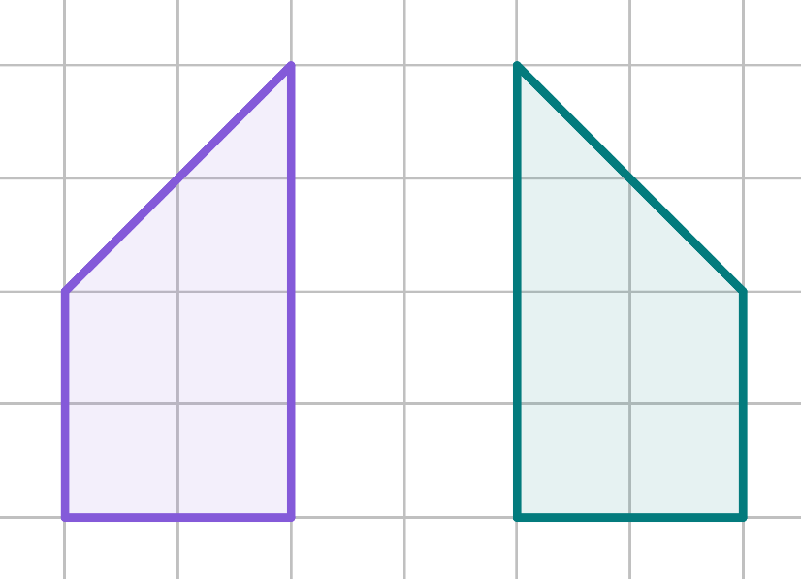
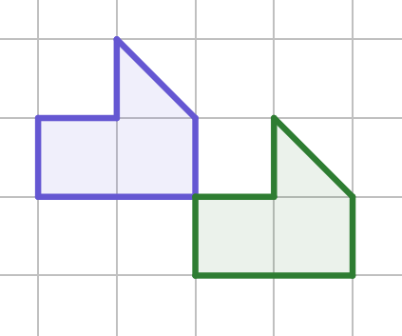
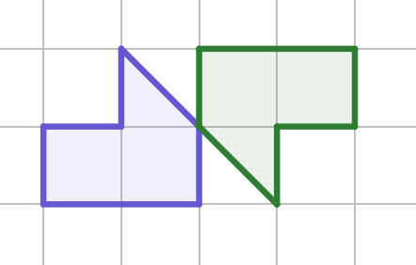
Checking understanding of basic transformations
Task B: Describing changes
Match the descriptions to the correct figure.
The image is congruent but mirrored.
The image is congruent and has the same orientation as the object.
The image is congruent but the orientation has changed from the object.
Complete the table regarding the properties of the image compared to the object and then use it to write a description.
Property | Changed - yes/no?
Orientation | yes
Lengths | no
Position | yes
Angles | no
Mirrored | yes
The lengths and angles are invariant. Its orientation and position has changed. It is a mirror image of the object.
Write a description for the two transformations.
a)
b)
Your descriptions may include:
The object and image are congruent but in a different position.
The image has a different orientation to the object.
Mathematics in Education and Industry.

